Slide 1
Thailand Inventory Change Summary
G580 vs Jun-25 | Aged WIP & Provision

Slide 2
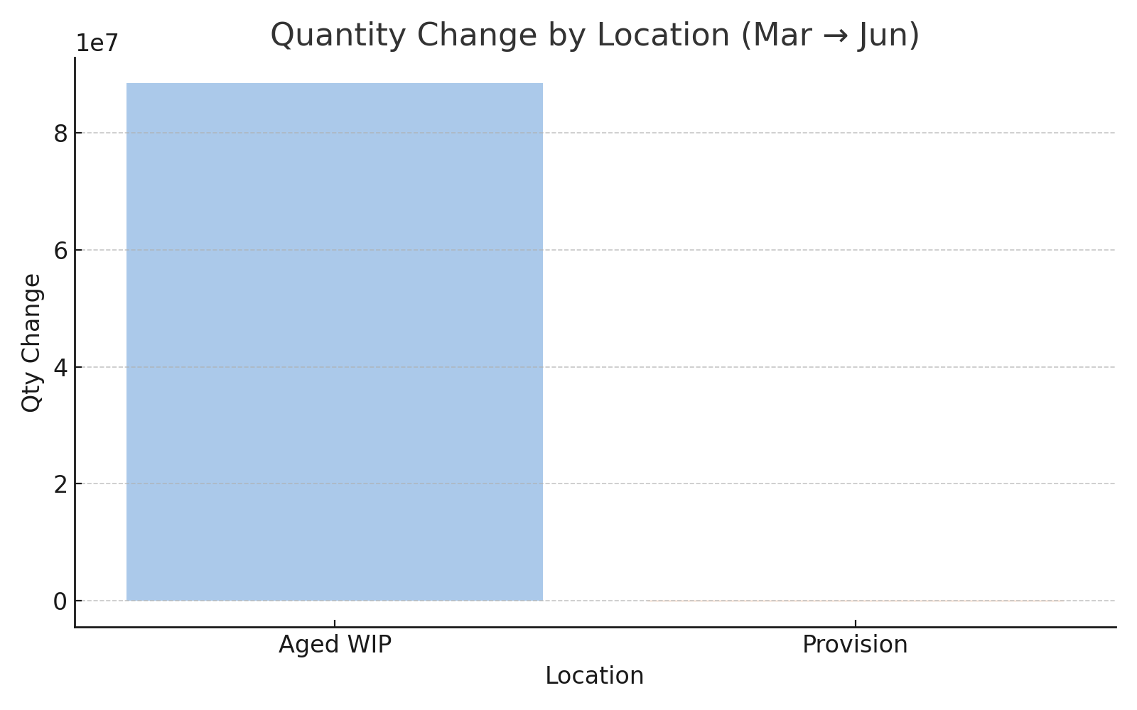
Thailand - Quantity Change by Location (Mar to Jun)

Slide 3
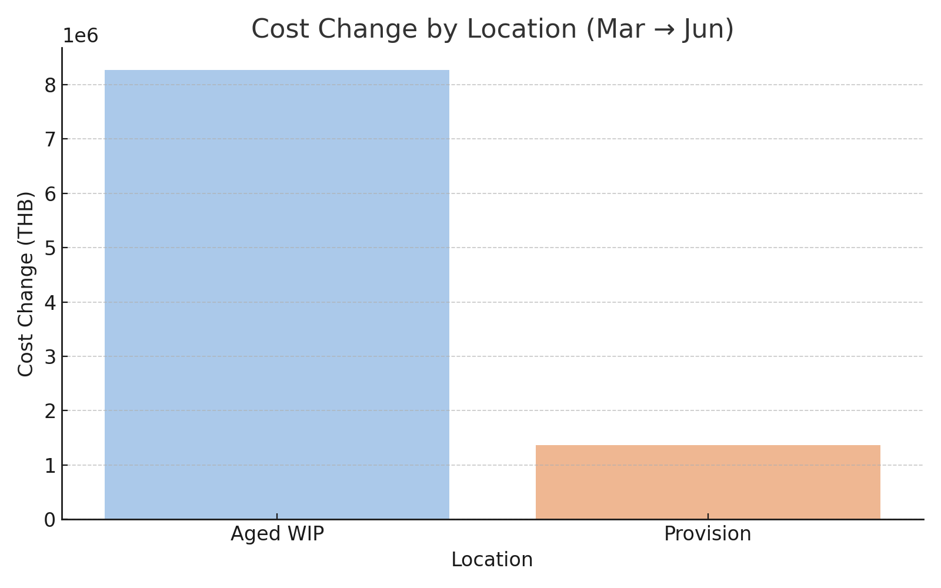
Thailand - Cost Change by Location (Mar to Jun)

Slide 4
Written Summary
• Aged WIP increased by ฿88.4M in quantity and ฿8.27M in cost.
• Provision inventory decreased by ~35,300 units but increased in value by ฿1.37M.
• Indicates WIP buildup and potential movement of lower-value provisions.
• See next slide for breakdown by product line and warehouse.

Slide 5
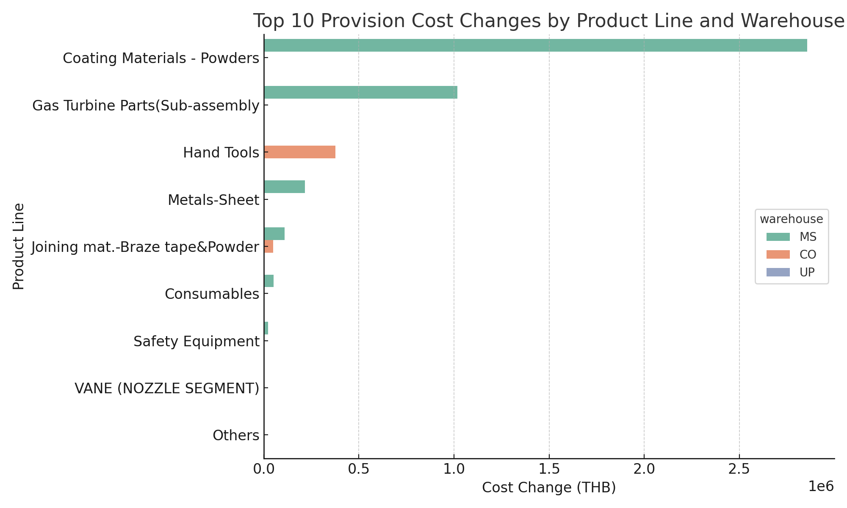
Top Provision Changes by Product Line and Warehouse

